Slide 2
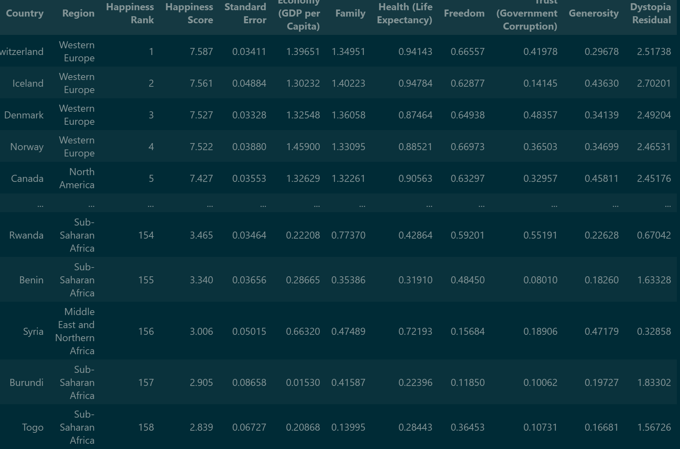
Dataset
Sum of it
Dataset → World Happiness Report

Slide 3
Project
Find the Correlation between the different parameters and the Happiness of the Different Countries and Areas of the World
Product

Slide 4
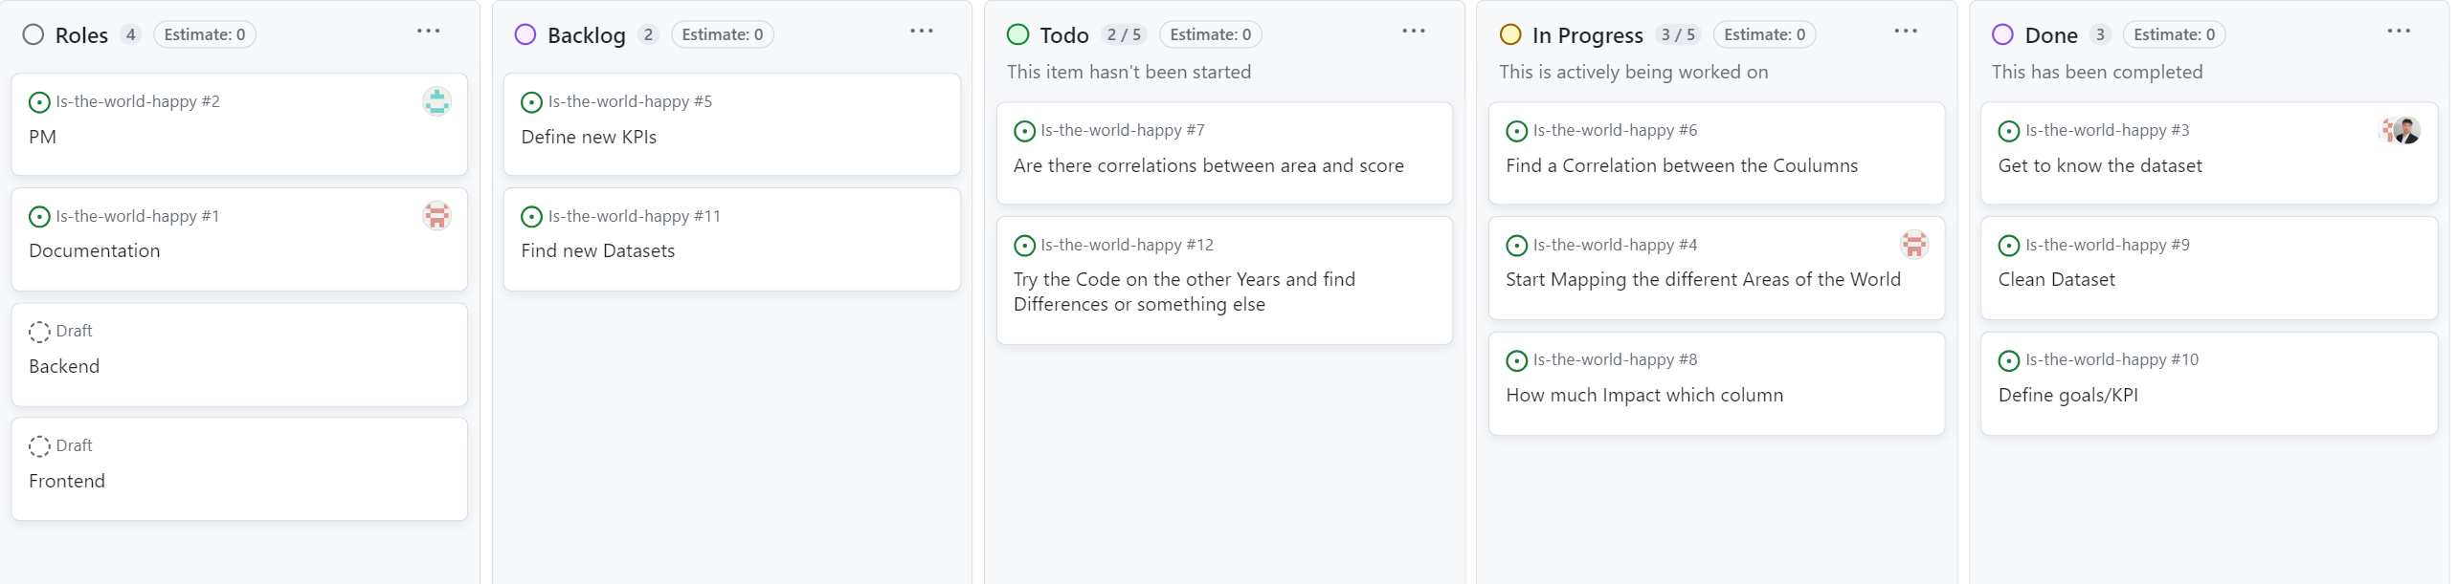
Tickets

Slide 5
KPIs
Step 04
Step 03
Step 02
Step 01
Plot the Data in different diagrams
Find Correlation between the Columns
Clean the Dataset (if needed)
Get Known with the Dataset

Slide 6
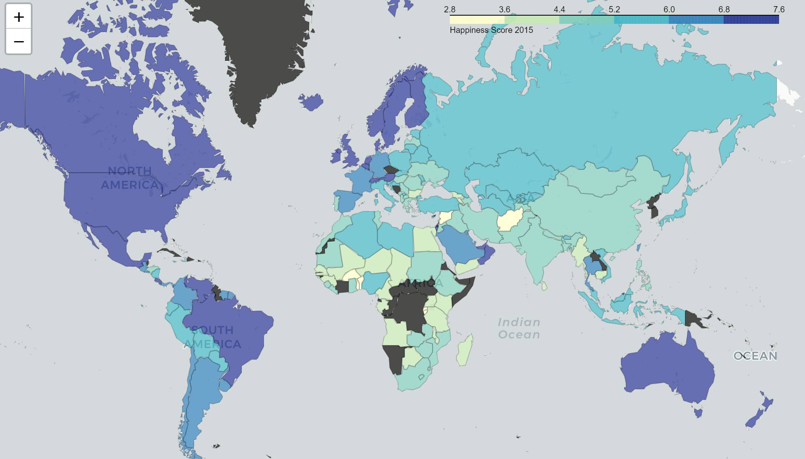
What we‘ve done so far
Mapping, plotting and visualization

Slide 7
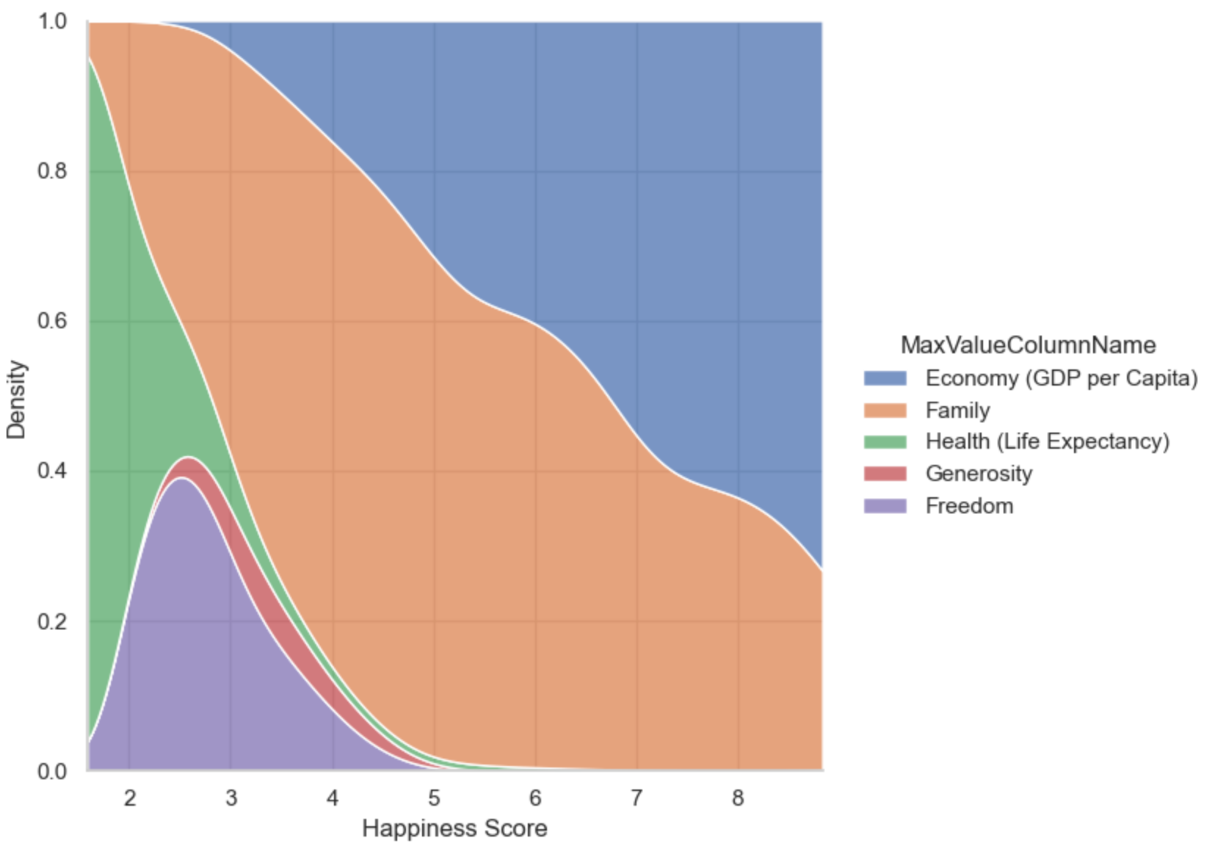
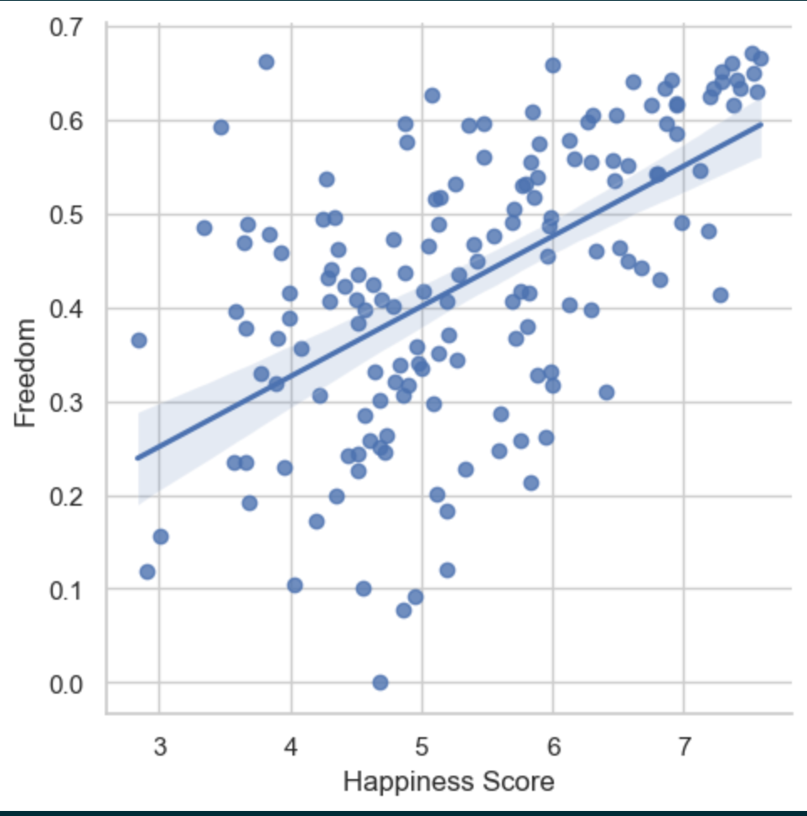
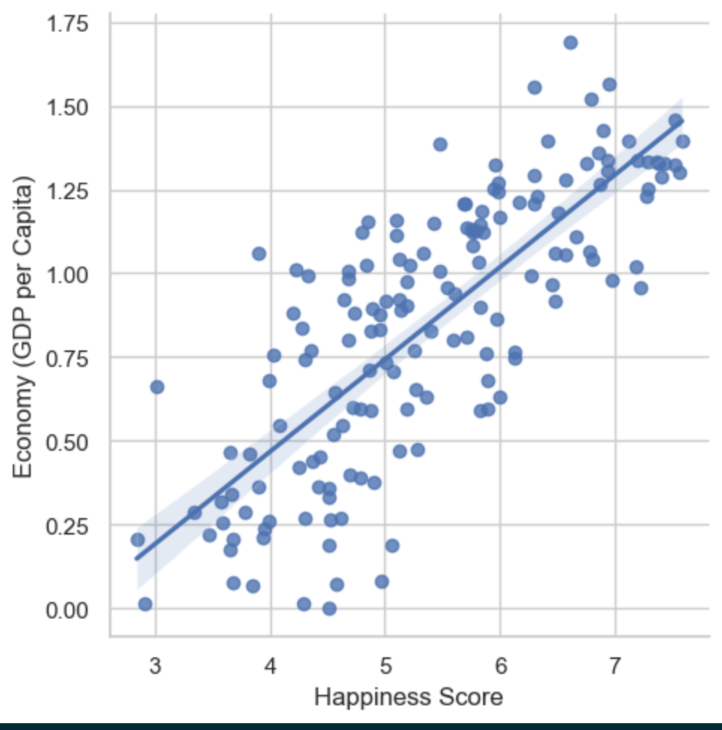
What we‘ve done so far
Correlation between Columns

Slide 8
Next Steps
Finish the Task not everyone worked enough on the Dataset to continue
Try the Different years of the Dataset, now only 2015 (2016 and 2017 available)
Collect to result in one Notebook
Optional: If we have time and Energy for this search for new Dataset which could fit

Slide 9
What‘s about the time
1.Week
2.Week
3.Week
4.Week
…
Get Finished with Task
Use the other Years from the Dataset
Collect all results in one notebook
Work with more Datasets
Optional

